Slide 1
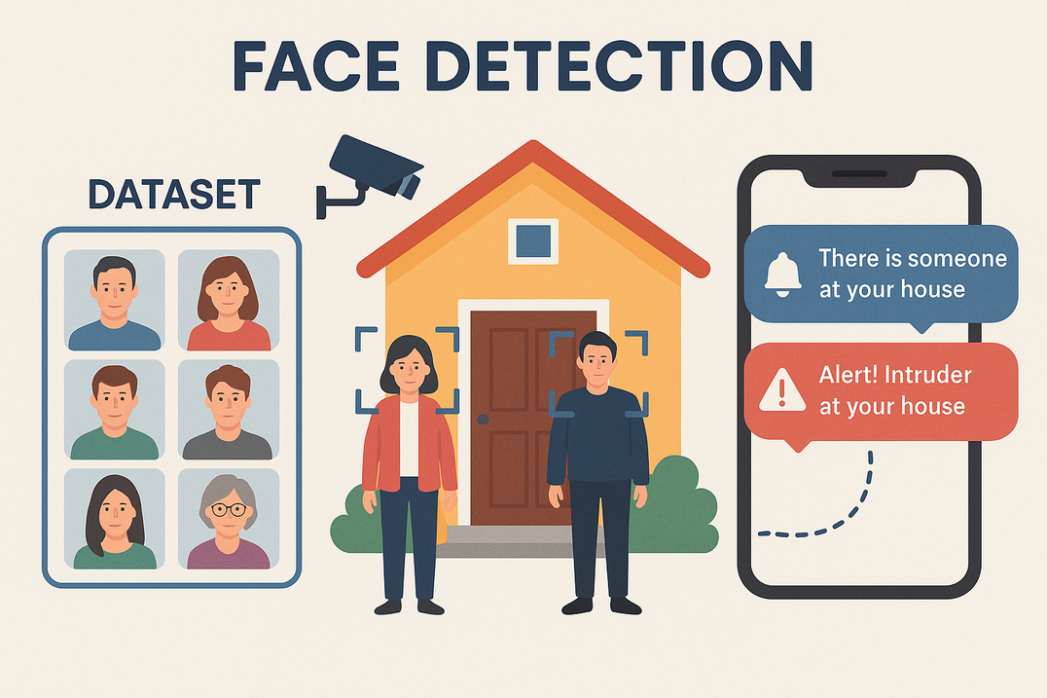
Smart Face Detection & Intruder Alert System
Software-only system to monitor home entrances and send mobile notifications for known or unknown faces.

Slide 2
Project Objective
Develop real-time face detection and recognition for home entrance monitoring.
Maintain secure dataset of known individuals.
Send instant notifications for recognized persons.
Alert immediately on unknown intruders.
Build user-friendly mobile app for alerts management.

Slide 3
Technology Stack
Face Detection
OpenCV / MediaPipe / Dlib
Face Recognition
FaceNet / Dlib / DeepFace
Backend
Python with Flask / FastAPI
Notification
Firebase Cloud Messaging / Push API
Mobile App
Flutter / React Native / Android Studio
Dataset Storage
Local or Firebase / SQLite
Camera Source
USB / Webcam / CCTV IP camera

Slide 4
System Workflow
Real-time video feed from entrance camera
2.Face detection using OpenCV or MediaPipe
3.Face recognition via embeddings (FaceNet)
4.Decision: Notify "Someone at your house" if matched
5.Notify "Alert! Intruder at your house" if no match
6.Send notification to mobile app

Slide 5
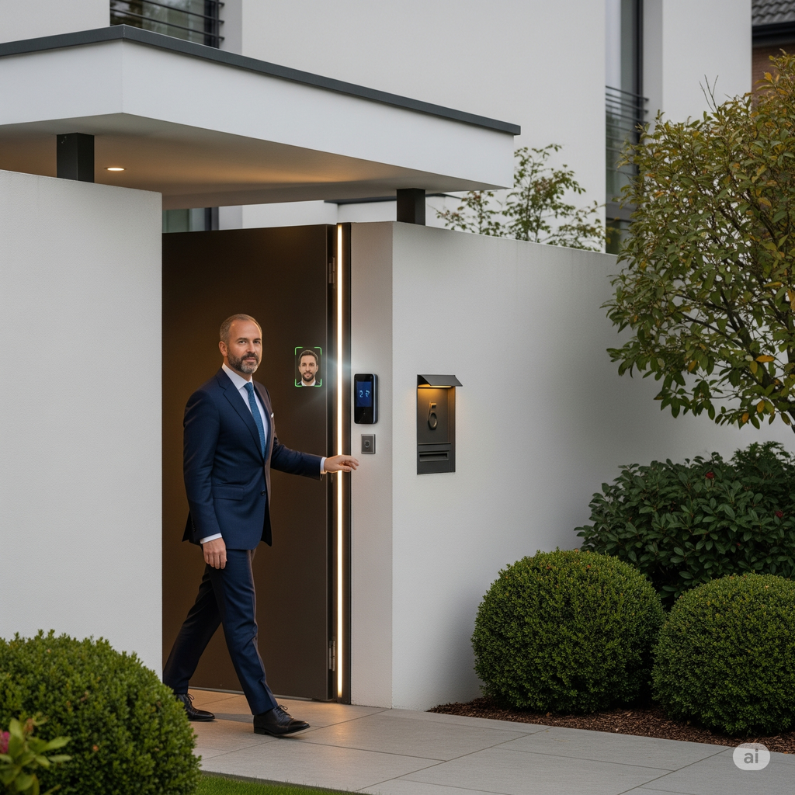
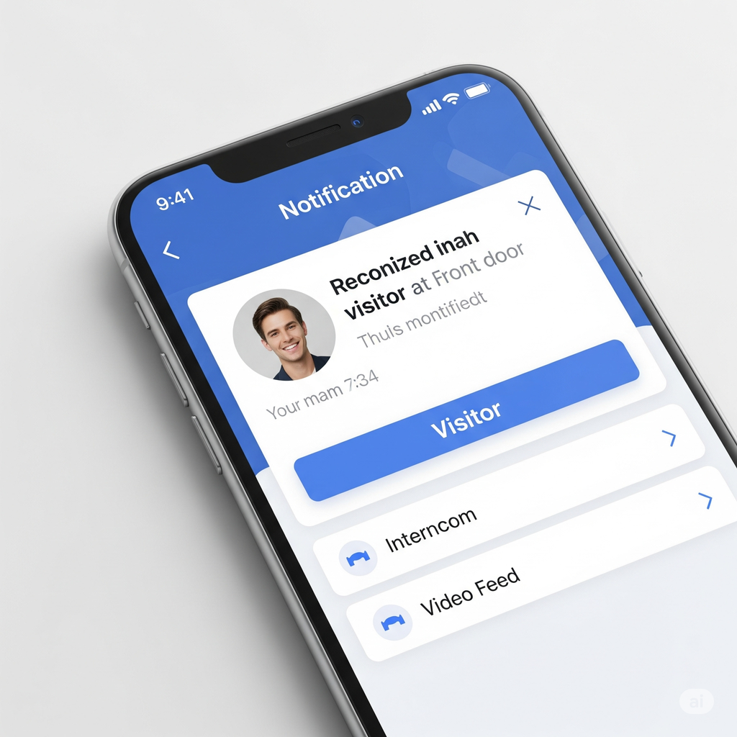
Known Person Detection
When a recognized face is detected, the system sends a notification: "Recognized visitor at your house."

Slide 6
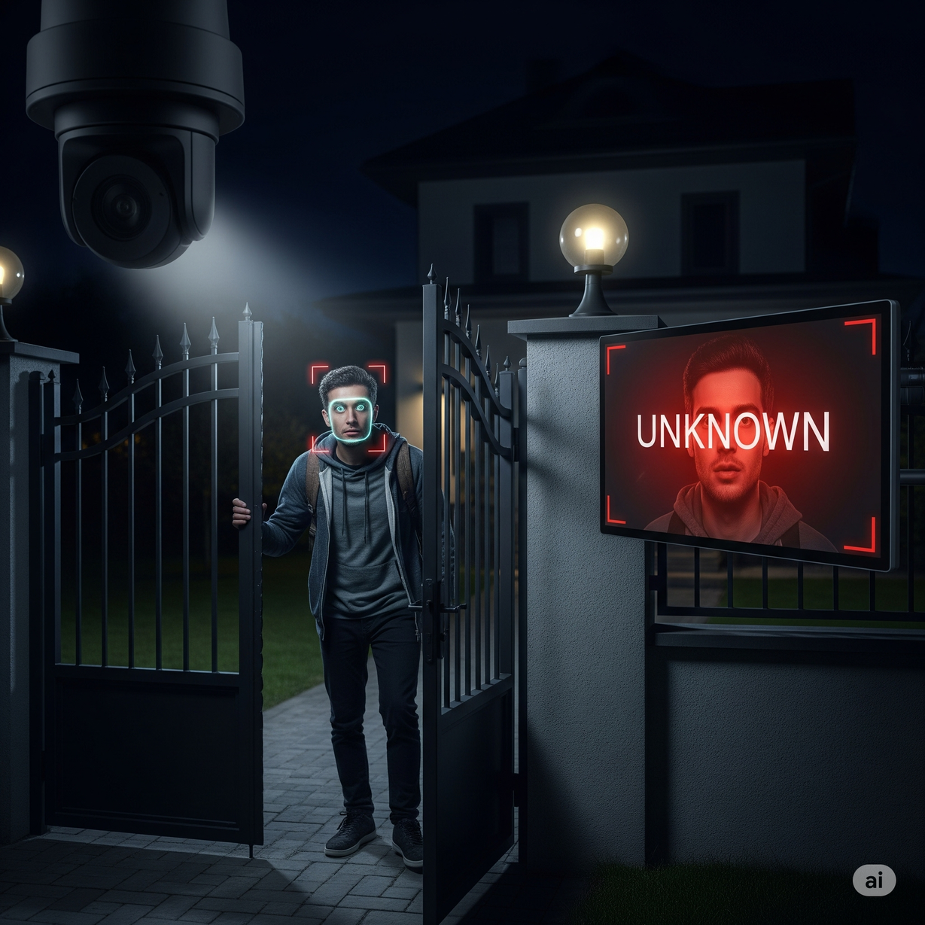
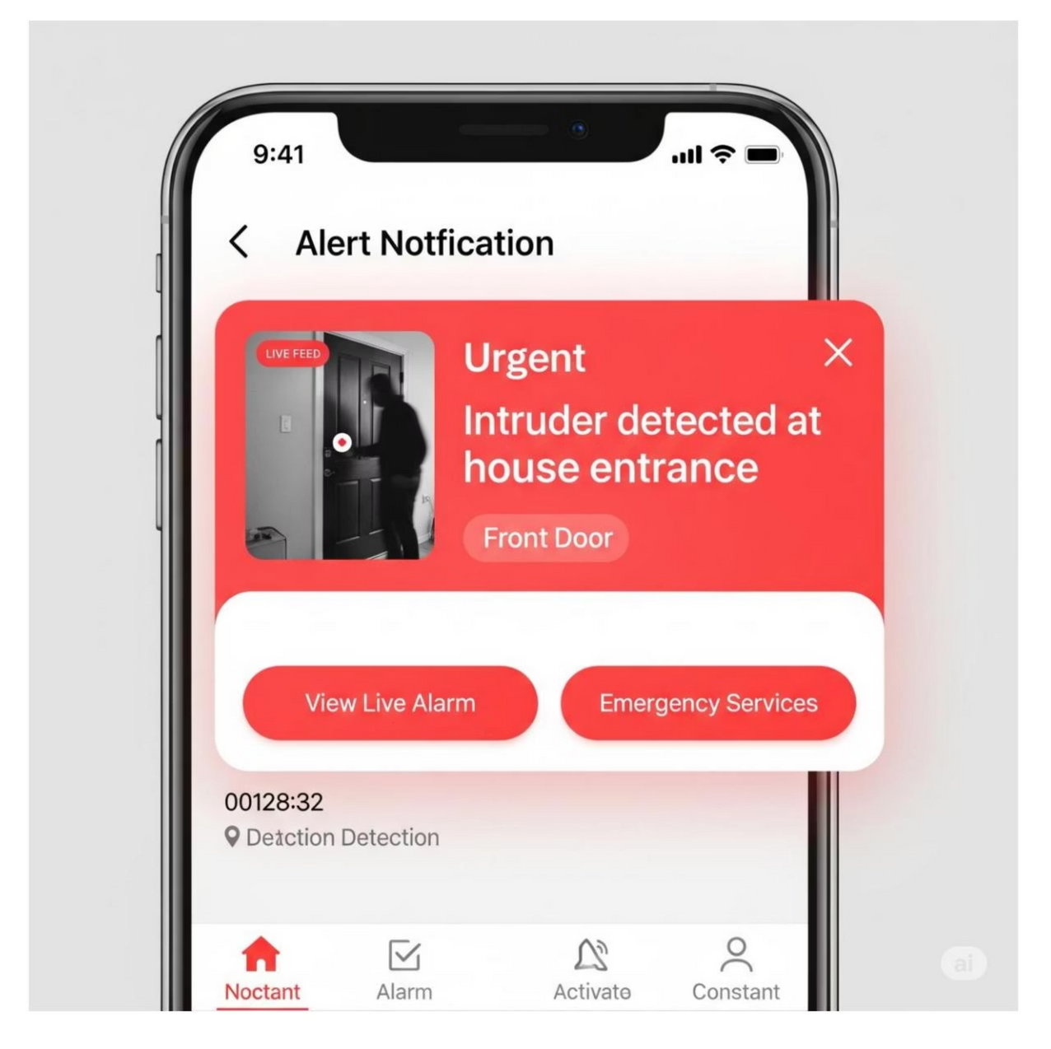
Intruder Detection
If an unknown face is detected, the system immediately alerts: "Alert! Intruder at your house."

Slide 7


Summary & Benefits
Fully software-based real-time face detection and recognition.
Enhances home security without physical hardware.
Instant mobile notifications for known and unknown visitors.
User-friendly mobile app for alert management.

